Slide 1
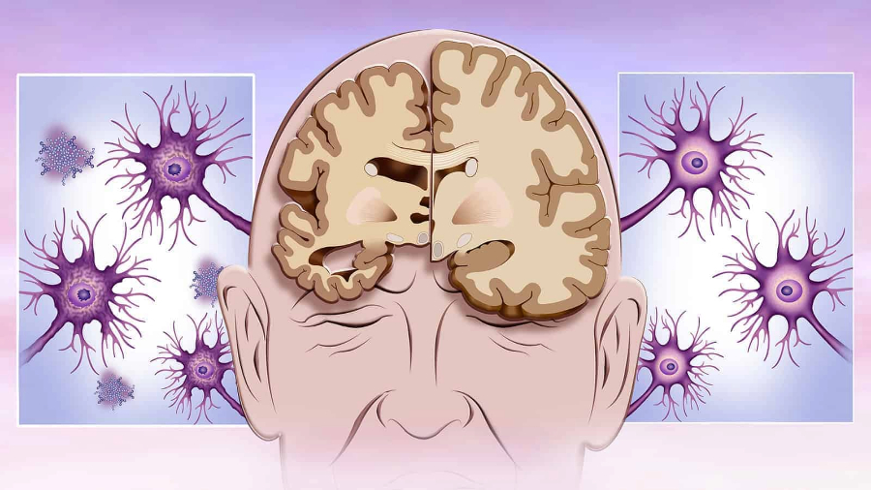
Presented by - Somnath Banerjee
Machine Learning-Based Handwriting Analysis of the DARWIN Dataset for Early Alzheimer's Disease Prediction

Slide 2

Introduction
Alzheimer's disease (AD) is a progressive neurodegenerative disease that affects memory, thinking, and behavior.
Early diagnosis is crucial for timely intervention and improved patient outcomes.
Traditional methods for AD diagnosis can be expensive and invasive.

Slide 3

Motivation
Handwriting analysis offers a potential non-invasive and easily accessible tool for AD detection.
Changes in handwriting patterns can be associated with cognitive decline in AD patients.
Machine learning (ML) can effectively analyze handwriting features and identify patterns.

Slide 4

Problem Statement
Can machine learning-based analysis of handwriting samples from the DARWIN dataset effectively predict early Alzheimer's disease?
What specific features in handwriting are most relevant for AD prediction using machine learning models?

Slide 5

The DARWIN Dataset
The DARWIN dataset is a valuable resource for handwriting-based AD research.
It comprises handwriting samples from individuals with and without AD, along with clinical and cognitive data.
This dataset allows for training and evaluating machine learning models for AD prediction using handwriting analysis.

Slide 6

Literature Review
Existing research supports the potential of handwriting analysis for AD detection.
Studies have identified various handwriting features associated with AD, such as writing speed, pressure, and pen trajectory.
Machine learning has shown promising results in AD diagnosis using diverse modalities like MRI scans and cognitive assessments.

Slide 7
Research Methodology
1. Data Acquisition:
1.1 Dataset: DARWIN dataset (publicly available, designed for AD diagnosis via handwriting)
1.2 Composition: Diverse tasks (graphic, copy, memory, dictation) to capture various aspects of handwriting
1.3 Preprocessing: Cleaning and preparing data (missing values, feature conversion, exploratory analysis)
2. Feature Engineering:
• Dimensionality Reduction: Techniques like PCA to reduce feature count while preserving information
• Advanced Feature Selection: Identifying the most impactful features for accurate AD prediction

Slide 8
Research Methodology
3. Machine Learning Model:
3.1 Model Selection: Convolutional Neural Network (CNN) due to its effectiveness with image-like data
3.2 Training: Rigorous strategies (Stratified k-Fold Cross-Validation, Early Stopping) to ensure generalizability and prevent overfitting
4. Model Evaluation:
Various metrics like accuracy, balanced accuracy, ROC AUC, and F1-score
5. Conclusion:
Analyzed results, discussed implications, and outlined future research directions

Slide 9
Feature Engineering
Dimensionality Reduction: We employed Principal Component Analysis (PCA) to transform the initial 1,024 features into a more manageable space of 2,048 dimensions. This technique helps retain essential information while simplifying model training and reducing computational burden.
Advanced Feature Selection: We utilized Feature Importance analysis to identify the most impactful features that hold the key to accurate AD prediction. This approach goes beyond simply selecting features based on their individual characteristics and instead prioritizes features that contribute most significantly to the model's ability to distinguish between individuals with and without AD.

Slide 10
Machine Learning Models
1. Goal: Predict AD risk based on handwriting characteristics.
2. Model Selection:
Approach: Lazy Classifier (evaluates various algorithms)
Chosen Model: XGBoost (ensemble learning)
3. Neural Networks:
Basic: Learns patterns from data to predict AD probability.
Complex: Handles sequential data, extracts features, & uses regularization techniques.
4. Training: Automatic by Lazy Classifier (specific to each algorithm).

Slide 11
Model Training and Evaluation
1. Automatic Training:
Lazy Classifier handles training for all models.
Optimizes settings based on each algorithm.
2. Comprehensive Evaluation:
Accuracy, Balanced Accuracy, ROC AUC, F1-Score & Confusion Matrix.
3. Top Performer: XGBoost (91% accuracy, 93% balanced accuracy, 91% F1-score, 93% AUC).
4. Further Exploration:
Potential for improvement in other models with hyper-parameter tuning.
5. Next Steps:
Fine-tuning XGBoost for real-world application.

Slide 12
Result and Discussion
1. Top Performing Model: XGBoost achieved high accuracy (91.43%) and ROC AUC, and F1-score also exceeding 0.9.
2. Feature Importance Analysis:
Identified key handwriting characteristics driving model predictions.
Provides insights into the decision-making process and potential areas for further research.
3. Conclusion:
This study demonstrates the potential of machine learning to predict AD using handwriting data.
Further investigation into the identified features can enhance understanding of the link between handwriting and AD.

Slide 13
Limitation and Future Work
Limitations:
Dataset size and characteristics: Findings might not generalize to other populations or handwriting analysis methods.
Model limitations: Chosen model and features might not capture all relevant aspects of handwriting related to AD.
Need for validation: Further research on larger and more diverse datasets is necessary.
Future Work:
Additional features: Explore incorporating demographics, cognitive test scores, or other handwriting features.
Advanced deep learning: Investigate more sophisticated models designed for analyzing handwriting data.
Longitudinal studies: Assess model's ability to predict AD progression over time.

Slide 14
Conclusions
Key Findings:
Machine learning analysis of handwriting shows promise for early AD detection.
XGBoost achieved high accuracy and identified features associated with cognitive decline.
Significance:
Potentially non-invasive and accessible diagnostic tool.
Early detection could improve patient outcomes.
Provides insights into the link between handwriting and AD.
Future Directions:
Validate findings on larger, more diverse datasets.
Explore incorporating additional features and advanced models.
Conduct longitudinal studies to assess disease progression prediction.

Slide 15

Thank You!!!
Pursuit of Knowledge

